Slide 1

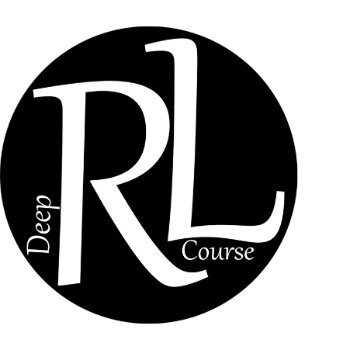

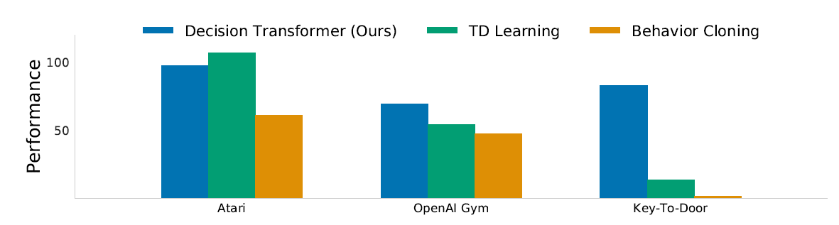
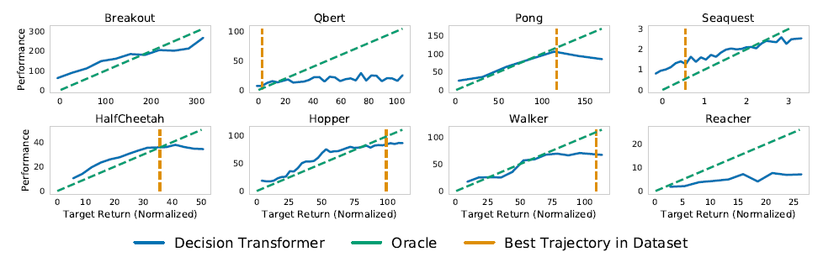
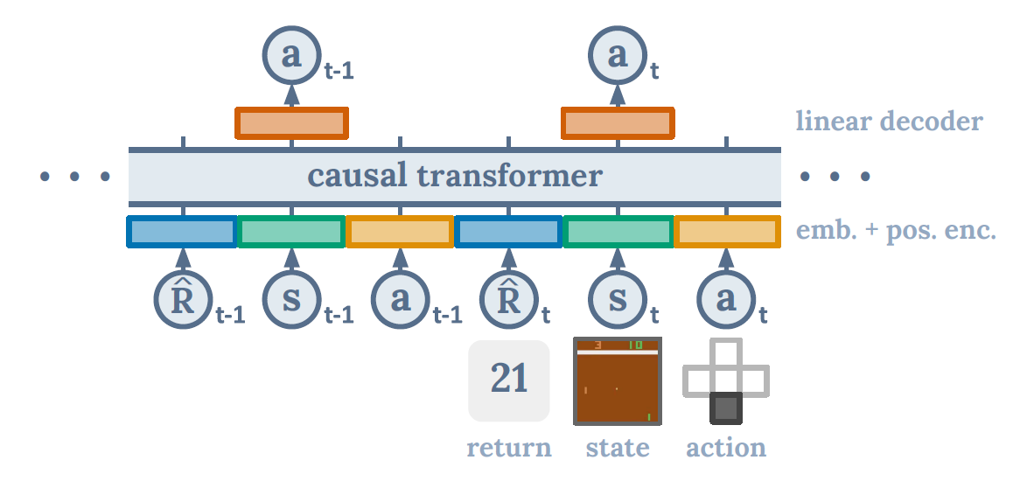
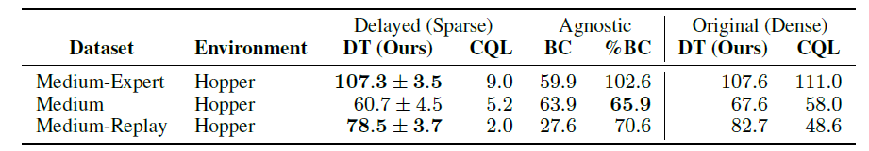

Transformers in RL: Decision Transformers vs. Traditional RL
Amirreza Tanevardi Iman Ahmadi
Sharif University of Technology
Objectives
Results
Traditional RL relies on value functions, policy gradients, or explicit environment models, which often face stability issues, poor credit assignment, and difficulty with sparse rewards.
Transformers, successful in NLP and vision, offer a new paradigm: treat RL as sequence modeling.
Does this new paradigm work?
Offline Benchmarks (Atari, OpenAI Gym, D4RL):
DT matches or exceeds strong baselines like CQL and behavior cloning.
Particularly strong in sparse reward and long-horizon credit assignment tasks.
Introduction
Reinforcement Learning (RL) aims to maximize cumulative reward by interacting with environments. Traditional RL methods (e.g., Q-learning, policy gradients) learn through bootstrapping and exploration but are often unstable and data-hungry.
Decision Transformers reframe RL as conditional sequence modeling: states, actions, and returns are tokens in a sequence, and a Transformer predicts actions autoregressively. This connects RL to supervised learning with large models.
Extensions such as Online Decision Transformers bridge offline pretraining with online fine-tuning, addressing exploration and adaptability.
Does Decision Transformer model the distribution of returns?
On every task, the desired target returns and the true observed returns are highly correlated.
On some tasks like Pong, HalfCheetah and Walker, Decision Transformer generates trajectories that almost perfectly match the desired returns
Method
Trajectory Representation
Encode trajectories as sequences of (return-to-go, state, action) tokens.
$$τ=\left({\hat{R}}_{1}, s_{1}, a_{1},{\hat{R}}_{2}, s_{2}, a_{2}, …,{\hat{R}}_{T}, s_{T}, a_{T}\right) {\hat{R}}_{t}=\sum_{t^{′}=t}^{T}{r_{t′}}$$
Condition on a target return → model generates actions aiming to reach it.
Architecture
GPT-style causal Transformer with modality embeddings (state, action, return).
Predicts next action autoregressively given past tokens. The model is as below:
Offline Training
Uses the architecture above
Trains like language models on offline trajectories.
Avoids value bootstrapping and explicit dynamics modeling.
Inference
We only have to provide the initial state and the desired return-to-go.
To generate the next action, we have to feed the next state and the desired return-to-go from that point on, which is calculated by subtracting the reward we got in the previous step from the initial return-to-go.
Does Decision Transformer perform well in sparse reward settings?
Decision Transformer can improve robustness in sparse reward settings since it makes minimal assumptions on the density of the reward.
Delayed returns minimally affect Decision Transformer
Conclusion
Decision Transformers demonstrate that RL can be cast as supervised sequence modeling, simplifying training and leveraging the power of large Transformer architectures.
Advantages: handles long horizons, sparse rewards, and offline data effectively. And can return optimal actions based on the desired return that you condition the model on.
Challenges: sample inefficiency, high compute cost, and careful trajectory design.
Outlook: With online extensions (ODT), Transformers provide a flexible and scalable framework for RL, potentially becoming a cornerstone for generalizable, data-driven agents.
References
Chen, Lili, Kevin Lu, Aravind Rajeswaran, Kimin Lee, Aditya Grover, Michael Laskin, Pieter Abbeel, Aravind Srinivas, and Igor Mordatch. Decision Transformer: Reinforcement Learning via Sequence Modeling. arXiv preprint arXiv:2106.01345, 2021. https://arxiv.org/abs/2106.01345
Wenzhe Li, Hao Luo, Zichuan Lin, Chongjie Zhang, Zongqing Lu, Deheng Ye. A Survey on Transformers in Reinforcement Learning. arXiv preprint arXiv:2301.03044, 2023. https://arxiv.org/abs/2301.03044
Qinqing Zheng, Amy Zhang, Aditya Grover. Online Decision Transformer. arXiv preprint arXiv:2202.05607, 2022. https://arxiv.org/abs/2202.05607
Janner, Michael, et al. "Offline Reinforcement Learning as One Big Sequence Modeling Problem." Proceedings of the 35th Conference on Neural Information Processing Systems (NeurIPS 2021), Sydney, Australia, 29 Nov. 2021, arXiv:2106.02039v4.

